Slide 1
Introduction
Maplearn Edu.
Members:
Date 06 Month 10 Year 2025
1. | Phạm Hoàng Tuấn | Student1614869
2. | Lâm Hoàng An | Student1614870
3. | Trần Hoàng Anh | Student1614884

Slide 2
Content
Introduction
Actual requirements
Requirements of the project
Deployment diagram
Test result
Conclusion and development
Task list

Slide 3
Introduction - Actual requirements
1. Provide function to store student and teacher data into database.
2. Provide information about the courses and educational content for students.
3. Teachers can create tests and manage students' learning experiences.
4. Manage Teacher information and Student enrollment.
5. Manage learning progress and assessment delivery.
6. Generate comprehensive educational statistics and reports.
7. Provide secure payment processing and transaction management.
8. Implement AI-powered learning assistance and support.

Slide 4
Introduction - Requirements of the project
Functional
1. Given Student Role
when browse courses then view, search, filter courses in catalog
when access learning then view video lessons, take notes, download resources
when take exams then attempt quizzes, view results, track progress
when manage profile then view, edit personal information, payment history
when use AI assistant then ask questions, get course consultation, receive help
when track progress then view completion status, certificates, achievements
Notes:
Non-functional (how the system works)
Functional (what the system should do)

Slide 5
Introduction - Requirements of the project
Functional
2. Given Teacher Role
when manage students then view student progress, enrollment status in course list
when manage courses then view, add, edit, remove a course in list
when manage exams then view, add, edit, remove an exam in list
when view reports then access student performance, course analytics, exam results
Notes:
Non-functional (how the system works)
Functional (what the system should do)

Slide 6
Introduction - Requirements of the project
Functional
2. Given Administrator Role
when manage users then view, add, edit, , verify students and teachers in list
when manage courses then view, add, edit, remove a course in list
when manage courses then view, approve, suspend, remove courses in platform
when manage payments then view, process, refund transactions in payment list
Notes:
Non-functional (how the system works)
Functional (what the system should do)

Slide 7
Introduction - Requirements of the project
Functional
2. Given Administrator Role
when manage courses then view, add, edit, remove acourse in list
when manage users then view, add, edit, , verify students and teachers in list
when manage courses then view, approve, suspend, remove courses in platform
when manage payments then view, process, refund transactions in payment list
Notes:
Non-functional (how the system works)
Functional (what the system should do)

Slide 8
Introduction - Requirements of the project
Non - functional
Usability
Intuitive user interface with clear navigation
Responsive design for all device types
Speed and Smooth
Fast page loading times and optimized performance
Smooth video streaming with adaptive quality
Efficient content delivery and caching
Notes:
Non-functional (how the system works)
Functional (what the system should do)

Slide 9
Introduction - Requirements of the project
Non - functional
Compatibility
Cross-browser support (Chrome, Firefox, Safari, Edge)
Mobile-responsive design for smartphones and tablets
Multiple operating system compatibility
Security and Safety
Secure user authentication and data protection
Anti-cheat systems for online examinations
Notes:
Non-functional (how the system works)
Functional (what the system should do)

Slide 10
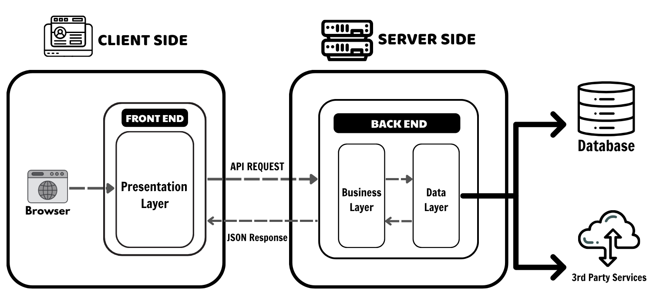
Introduction - Deployment diagram

Slide 11
Test Result
1. Student Profile Management OK
2. Teacher and Admin Management OK
3. Course Enrollment and Management OK
4. Course Content and Lesson Management OK
5. Invoice and Payment Management OK
6. Search and Filter Functionality OK
7. Exam and Assessment Management OK
8. Authentication and Access Control OK
9. Progress Tracking and Analytics OK
10. Invoice and Payment Details Management OK
11. AI Assistant and Support System OK

Slide 12
Conclusion
The Maplearn Edu platform will help users automate online learning processes, making education more accessible and efficient for students, teachers, and administrators. This system streamlines course management, student enrollment, progress tracking, and payment processing while providing AI-powered assistance and secure exam delivery. By integrating modern technologies and intuitive interfaces, Maplearn Edu creates a comprehensive solution that enhances the digital learning experience for all users.

Slide 13
Development
HTML/CSS
Tailwind CSS
Next.js (React Framework)
TypeScript
PHP
Laravel Framework
MySQL Database

Slide 14
Task List
No | Member | Contents |  | Table Name
1 | Phạm Hoàng Tuấn | Admin | Manager Course | courses course_chapters course_lessons lesson_view_histories
2 |  | Teacher | Manager Chapters Manager Lesson
3 |  | Student | View learning progress, system records lesson progress automatically
1 | Lâm Hoàng An | Admin | Manager User Manager Payment | users payment
2 |  | Teacher | View enrolled students
3 |  | Student | Make payment
1 | Trần Hoàng Anh | Admin | Manager Exam Papers | exam_papers exam_questions exam_attempts
2 |  | Teacher | Manager Exam Questions
3 |  | Student | Take Exam

Slide 15

Thank You

Slide 16
Reference
Aptech course

